Slide 1
32-bit Carry Look-Ahead Adder
Team DK
Darius San Agustin & Kevin Chen
EE 457 – Digital Integrated Circuits – Prof. Bruce Kim

Slide 2
Background & Introduction

Slide 3
Background & Introduction
Performs binary addition, just like the ripple-carry adder
Carry-Look Ahead adder computes all carry-in signals for all full adders in near-constant time
As opposed to the RCA which has a time complexity of O(n)

Slide 4
Background & Introduction
Use gates & modules designed in previous projects
Two-input NAND
CMOS Inverter
Two-input XOR
Full Adder

Slide 5
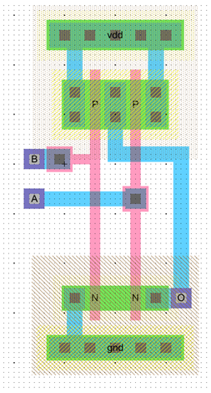
NAND

Slide 6
Inverter (with wells)

Slide 7
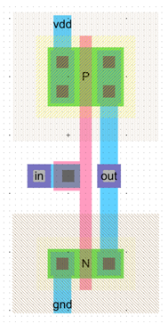
Inverter (No Wells)

Slide 8
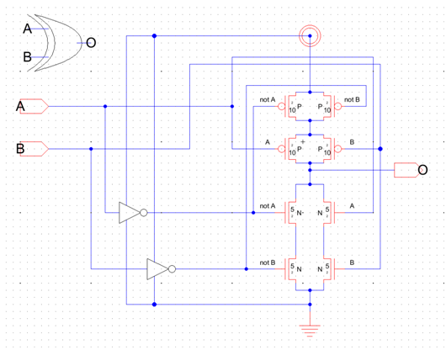
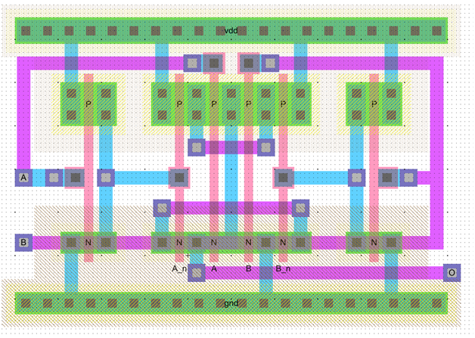
XOR

Slide 9
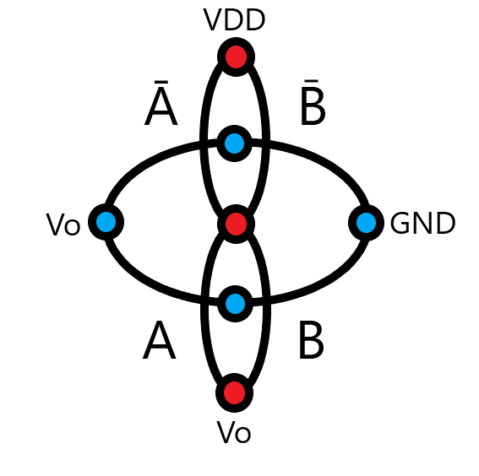
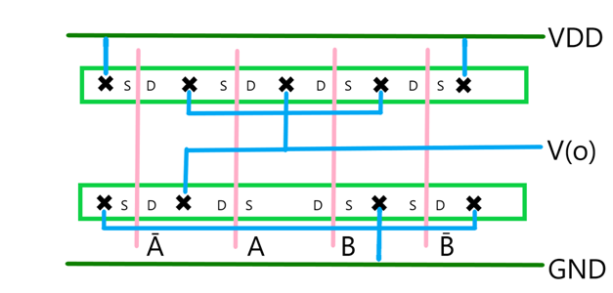
XOR

Slide 10
Background & Introduction
Modified Full Adder
Removed carry-out output
Added outputs for propagate P and generate G
$P_{i}=A_{i}⊕B_{i}= \overline{A_{i}}B_{i}+A_{i}\overline{{B }_{i}}$
$G_{i}=A_{i}∙B_{i}$

Slide 11
Background & Introduction
LCU Modules – C1, C2, C3
Computes carry-in signal for second, third, and fourth full adder, respectively
$C_{1}=G_{0}+P_{0}C_{in}$
$C_{2}=G_{1}+P_{1}G_{0}+P_{1}P_{0}C_{in}$
$C_{3}=G_{2}+P_{2}G_{1}+P_{2}P_{1}G_{0}+P_{2}P_{1}P_{0}C_{in}$

Slide 12
Background & Introduction
Extra modules for scalability
$P_{G}=P_{3}P_{2}P_{1}P_{0}$
$G_{G}=G_{3}+P_{3}G_{2}+P_{3}P_{2}G_{1}+P_{3}P_{2}P_{1}G_{0}$
This takes the same form as C3, so no need to design a new component!

Slide 13
Background & Information
With four full adders and all these LCU modules, we can design a four-bit CLA adder that’s scalable, i.e. usable in higher designs
We then use the four-bit CLA adders and the same LCU modules to build a 16-bit CLA
We scale up again, using the 16-bit CLAs to build the final circuit: the 32-bit CLA

Slide 14
Electric Schematic

Slide 15
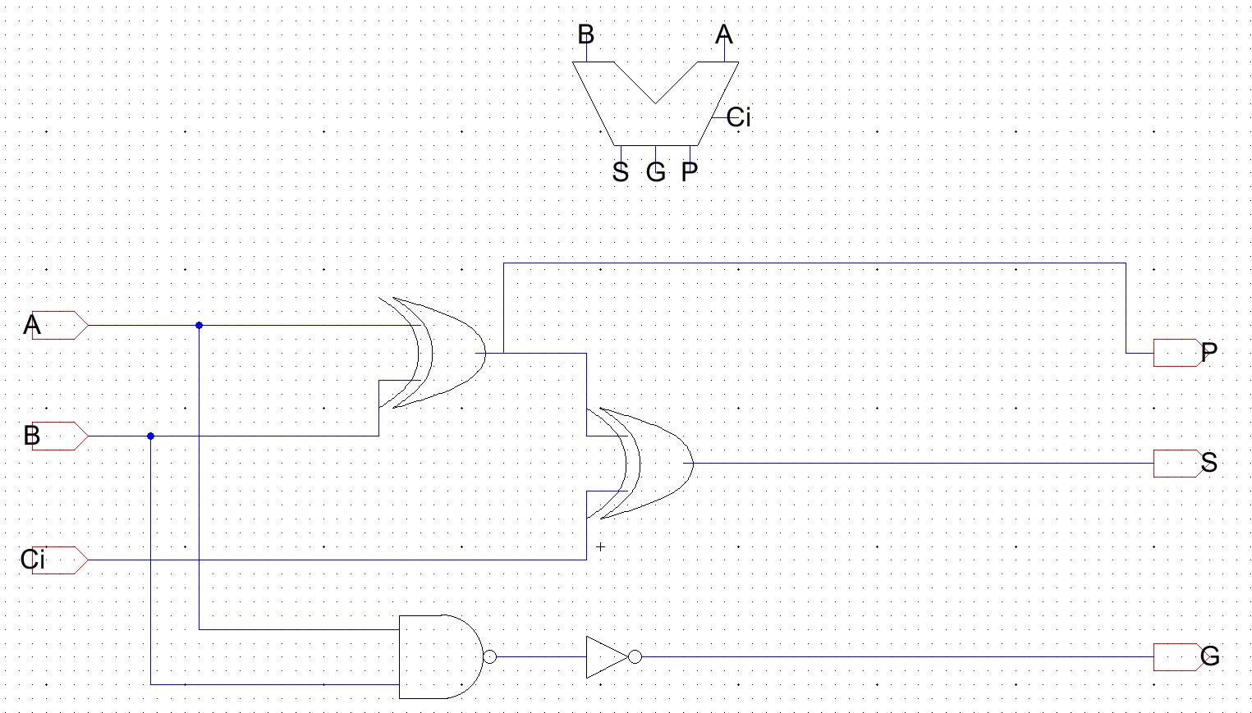
Modified Full Adder
$S=A⊕B⊕C_{i}$
$P=A⊕B$
$G=A∙B$

Slide 16
C1 Module

Slide 17
C2 Module

Slide 18
C3 Module

Slide 19
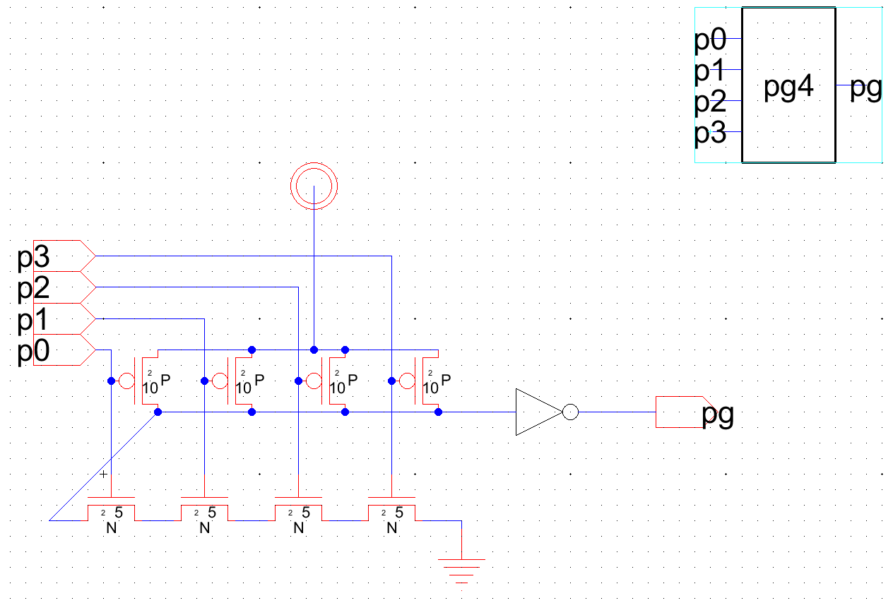
PG4 Module

Slide 20
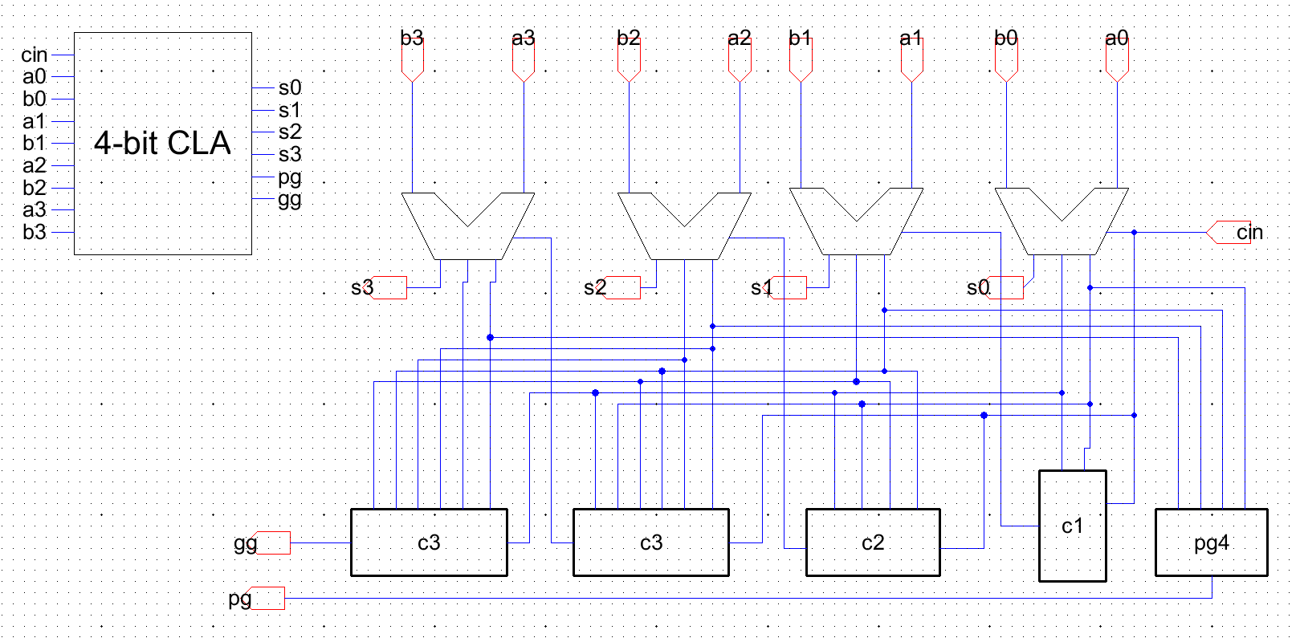
4-bit Fast Adder

Slide 21
16-bit Fast Adder

Slide 22
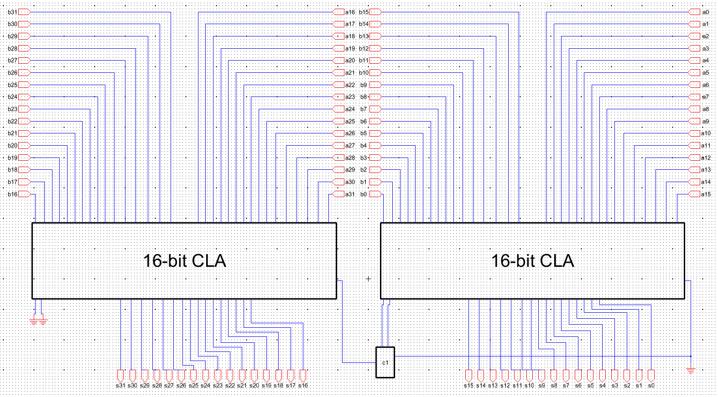
32-bit Fast Adder

Slide 23
32-bit Fast Adder (No boxes!)
Screenshots are separate due to rendering issues with Electric
This is an overview

Slide 24
Electric Layout

Slide 25
Modified Full Adder

Slide 26
C1 Module

Slide 27
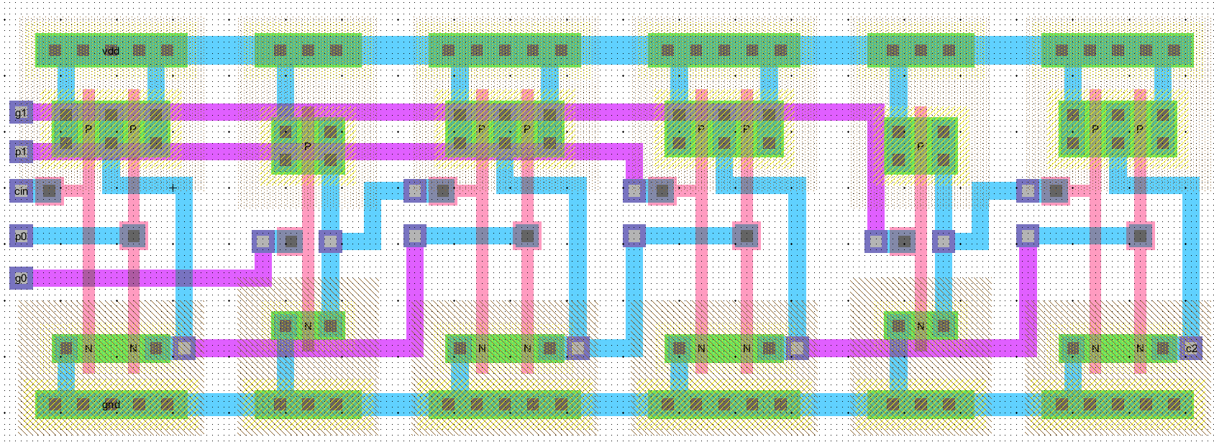
C2 Module

Slide 28
C3 Module
NAND and Inverter layouts used here are slightly taller than in the C1 and C2 modules
Also in the PG4 module, next slide

Slide 29
PG4 Module

Slide 30
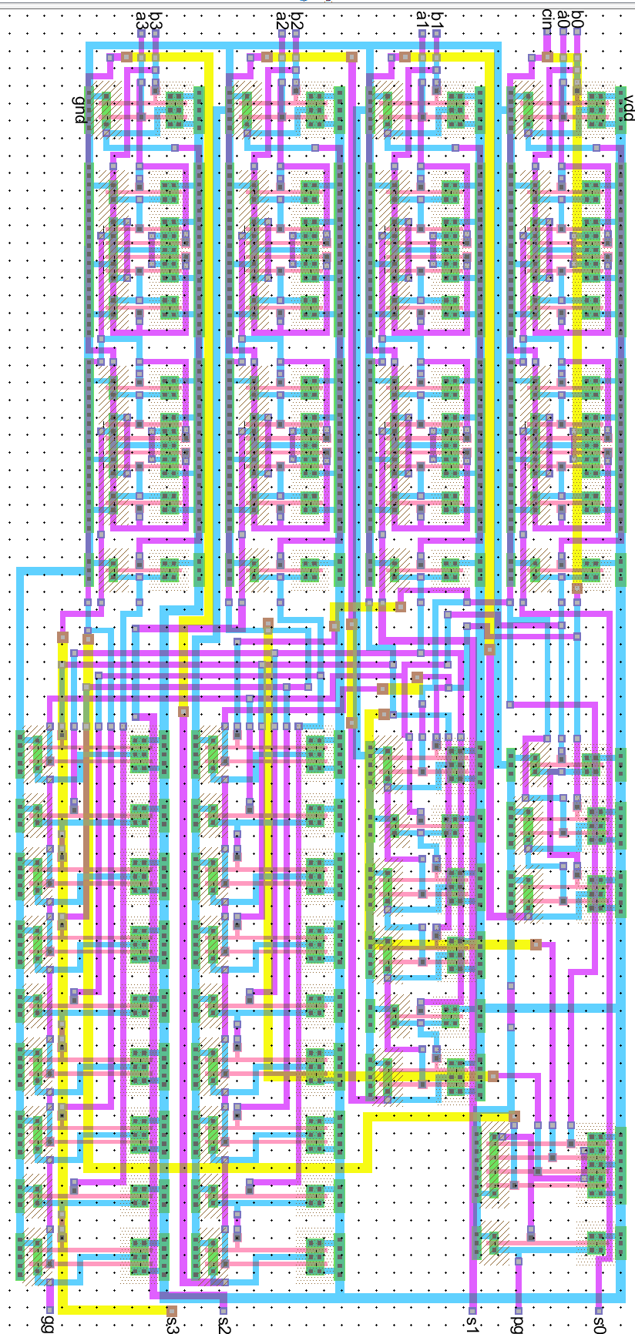
4-bit Fast Adder

Slide 31
16-bit Fast Adder

Slide 32
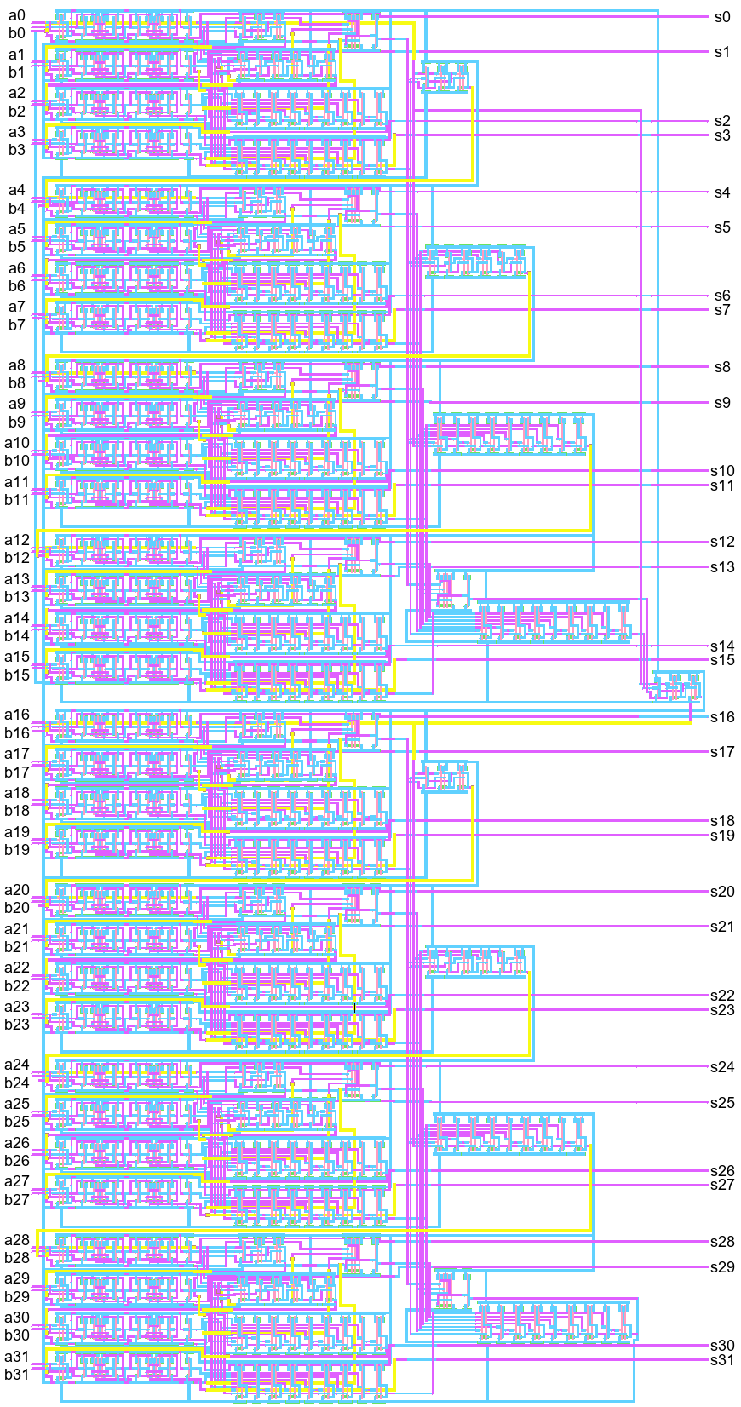
32-bit Fast Adder (Overview)

Slide 33
32-bit Fast Adder (top)

Slide 34
32-bit Fast Adder (bottom)

Slide 35
IRSIM Logic Simulations

Slide 36
Additions
Total of Five Additions
 | Input: A (Hexadecimal) | Input: B (Hexadecimal) | Expected Output: S (Hexadecimal)
First Addition | 0x7FFFFFFF | 0x00000001 | 0x80000000
Second Addition | 0x7FFFFFFF | 0x80000000 | 0xFFFFFFFF
Third Addition | 0x12162019 | 0x00040000 | 0x121A2019
Fourth Addition | 0x11031997 | 0x01130682 | 0x12162019
Fifth Addition | 0x09161998 | 0x09000681 | 0x12162019

Slide 37
Additions
Total of Five Additions
 | Input: A (Decimal) | Input: B (Decimal) | Expected Output: S (Decimal)
First Addition | 2147483647 | 1 | 2147483648
Second Addition | 2147483647 | 2147483648 | 4294967295
Third Addition | 303439897 | 262144 | 303702041
Fourth Addition | 285415831 | 18024066 | 303439897
Fifth Addition | 152443288 | 150996609 | 303439897

Slide 38
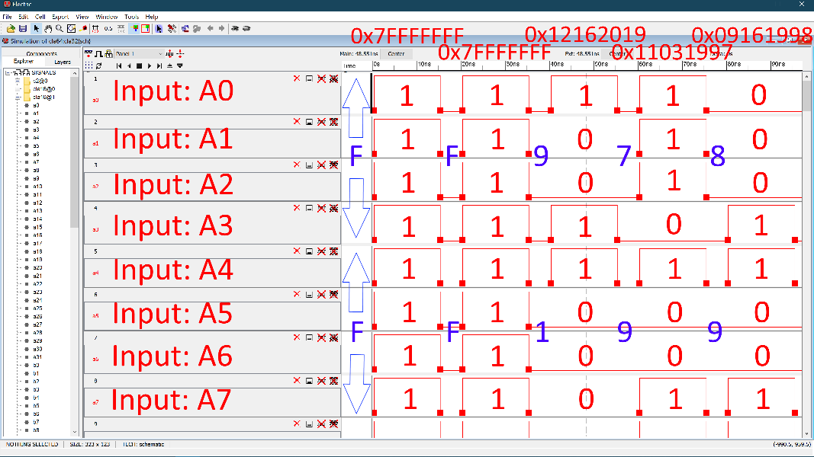
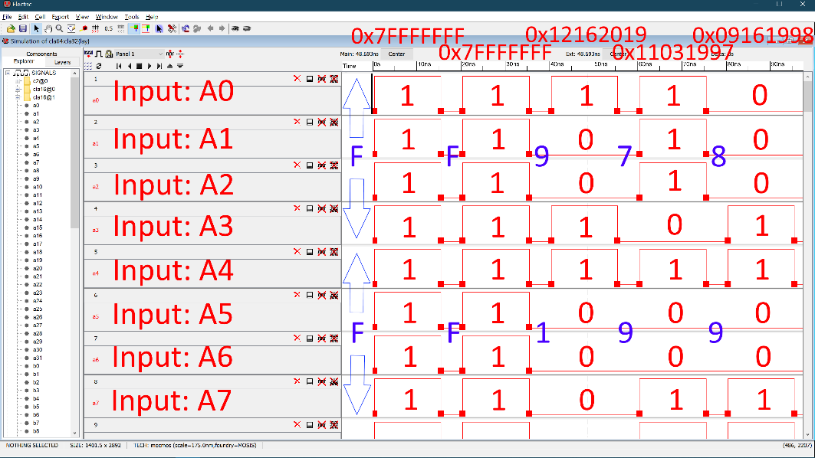
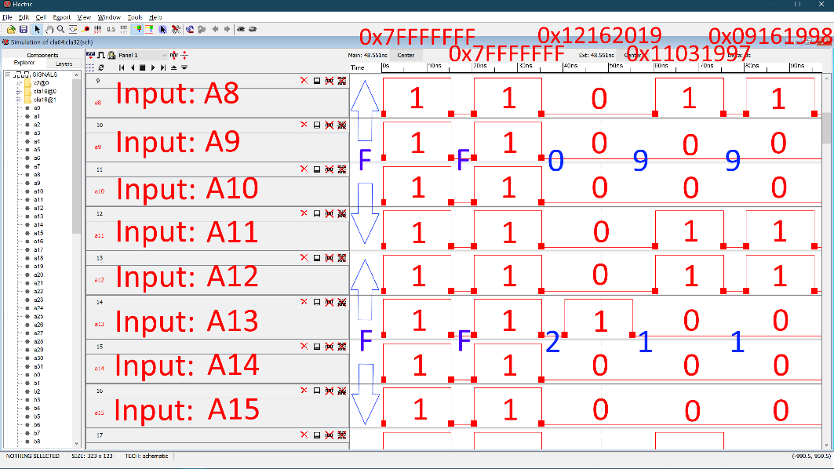
Waveforms – Input A(0:15)

Slide 39
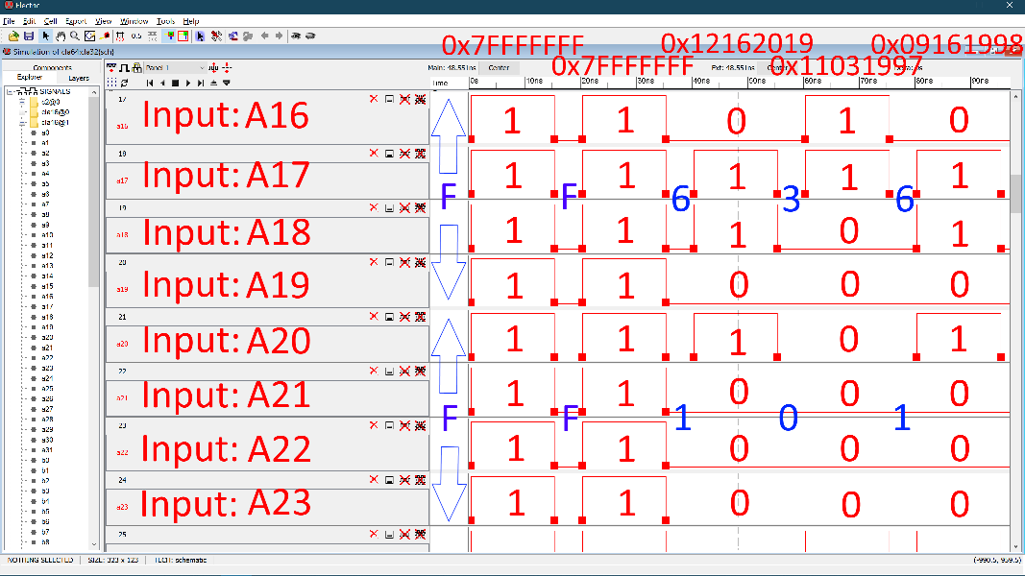
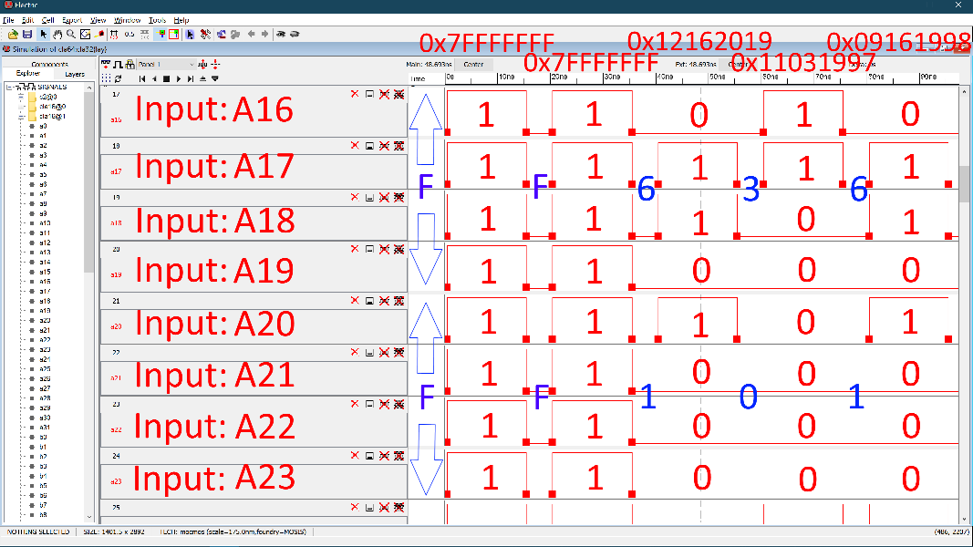
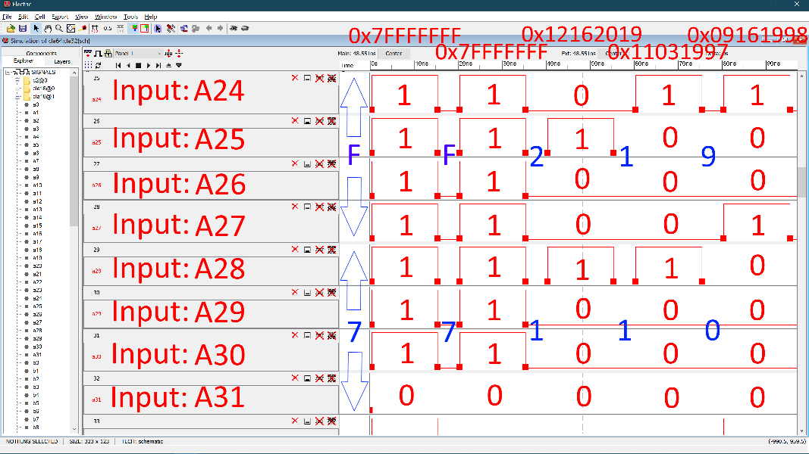
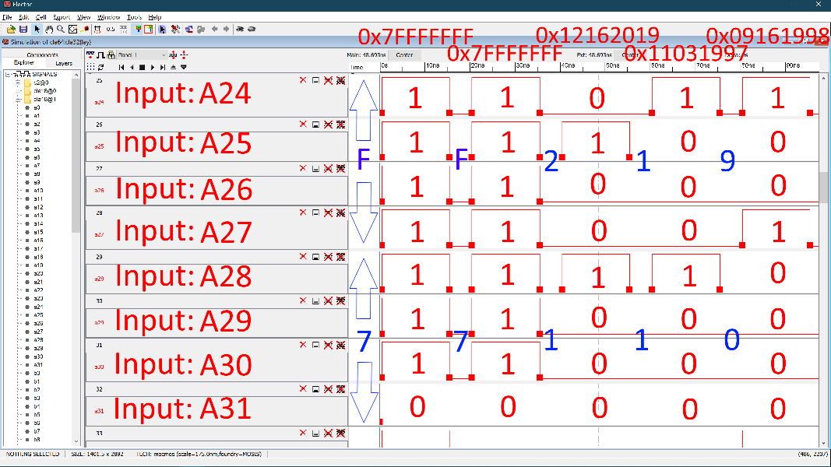
Waveforms – Input A(16:31)

Slide 40
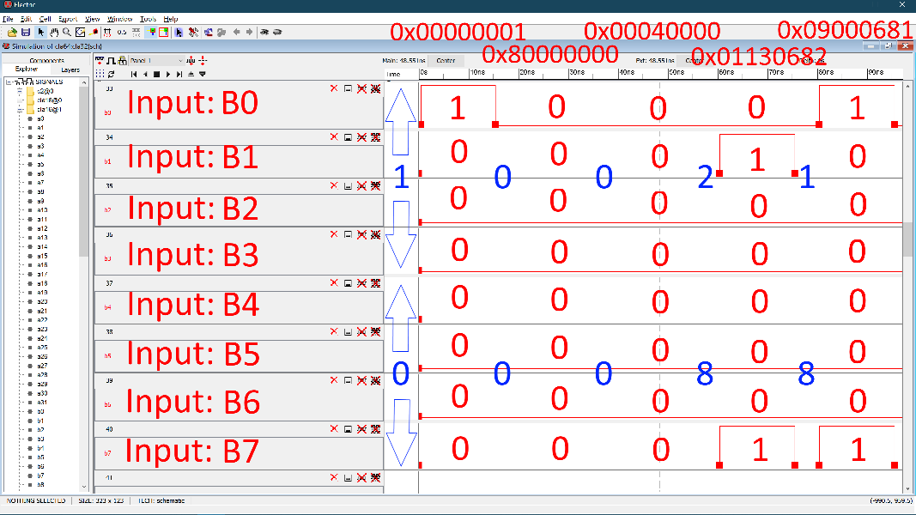
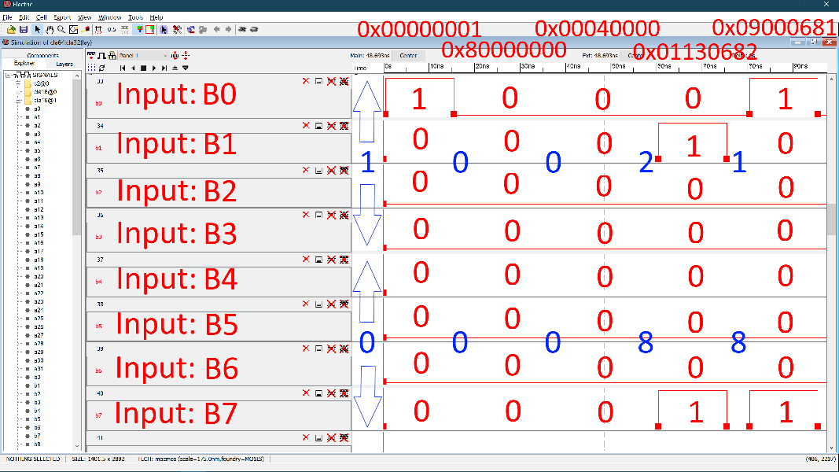
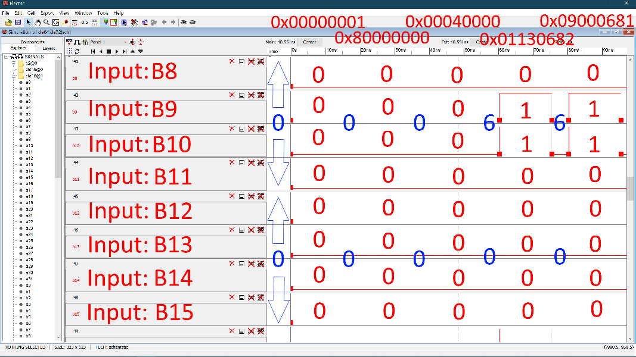
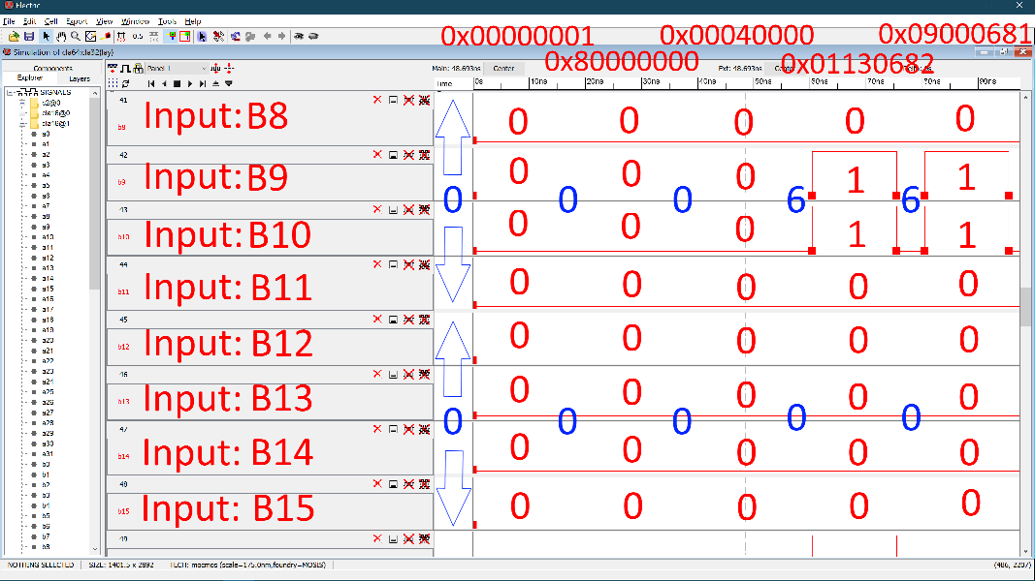
Waveforms – Input B(0:15)

Slide 41
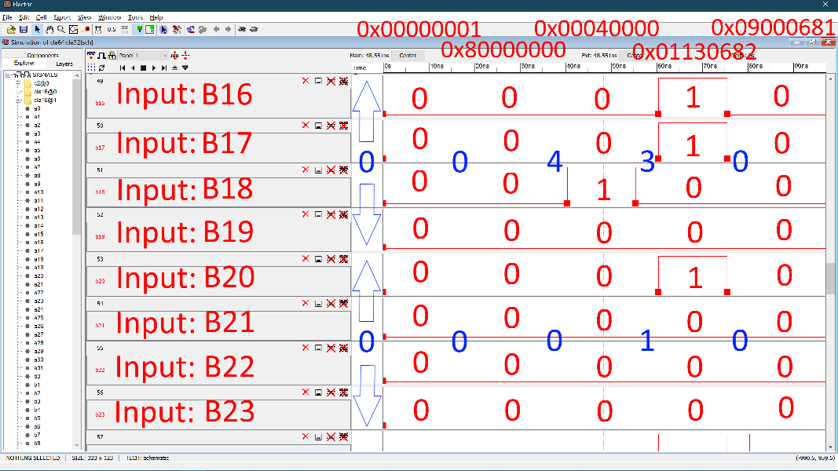
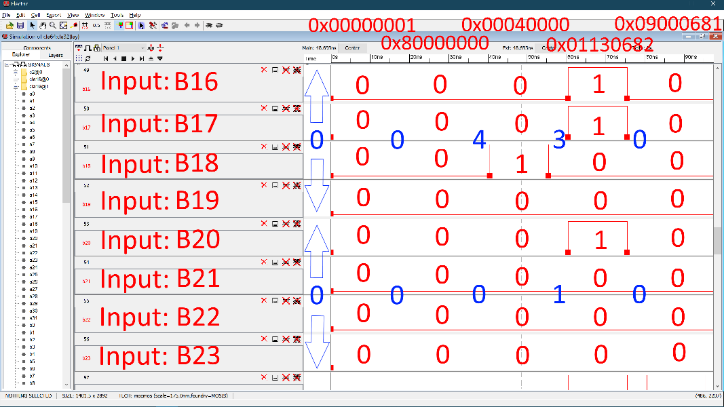
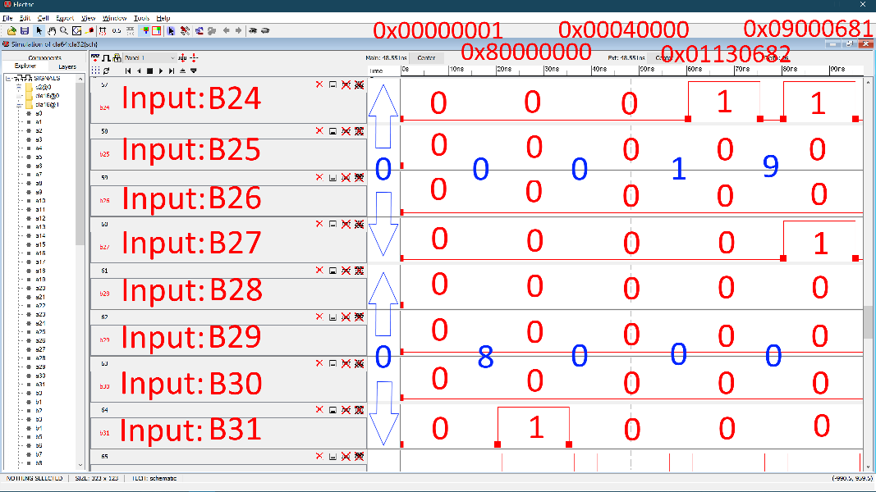
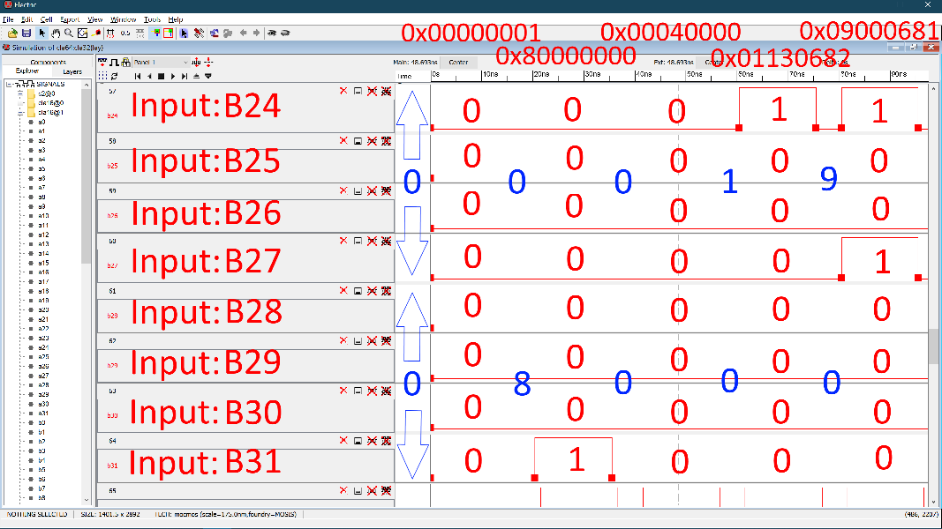
Waveforms – Input B(16:31)

Slide 42
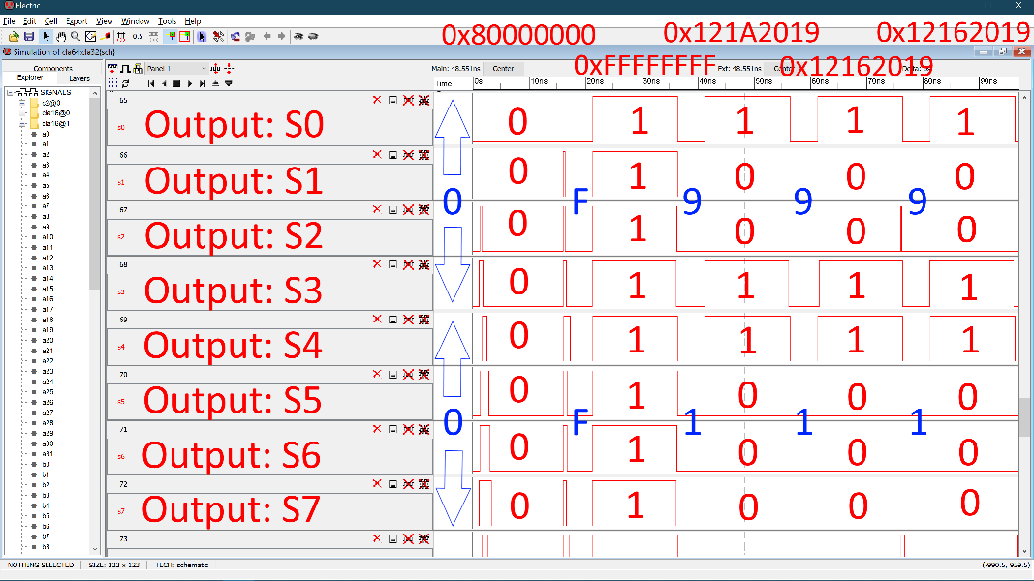
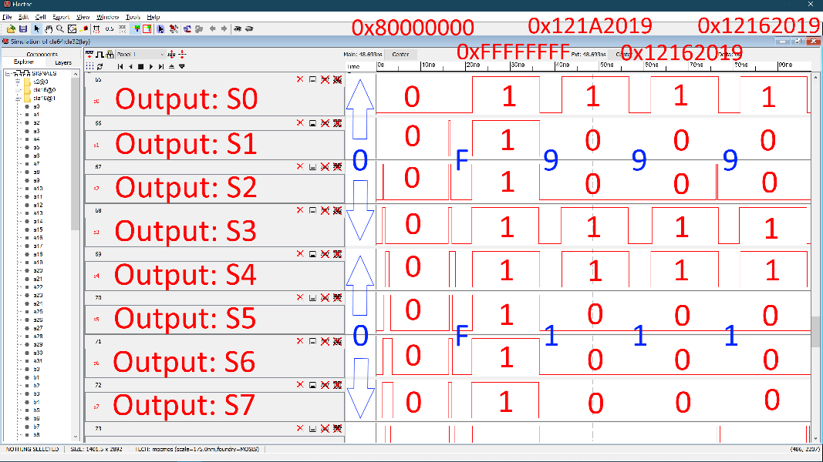
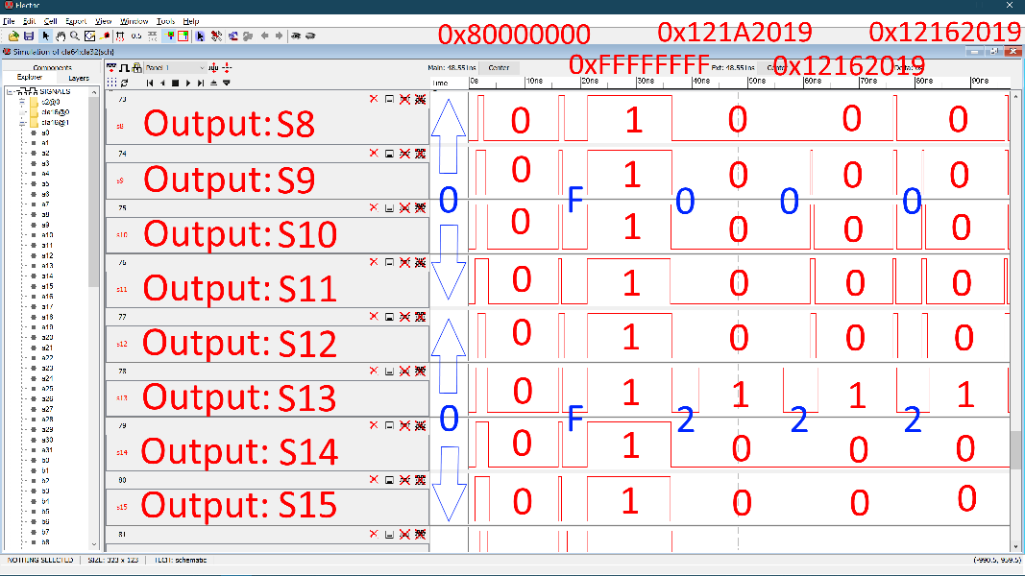
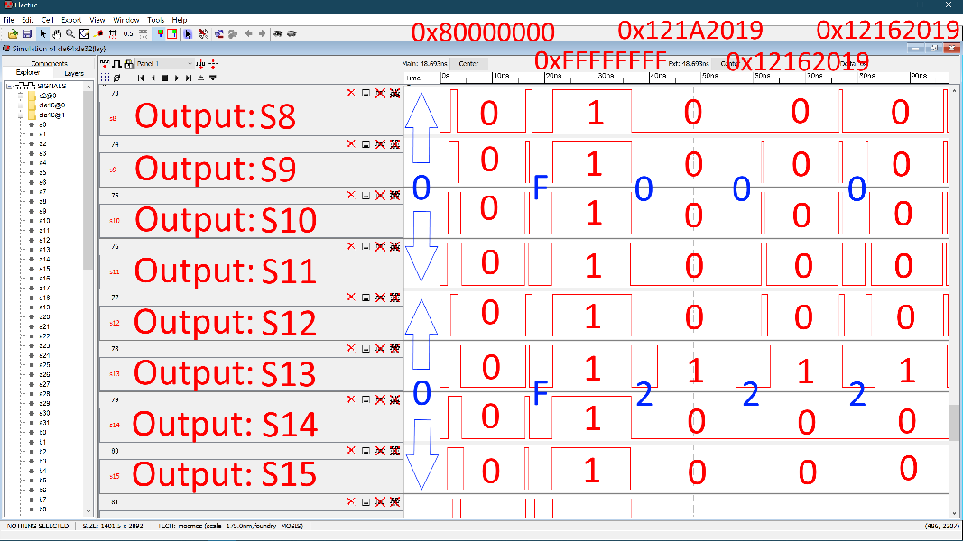
Waveforms – Output S(0:15)

Slide 43
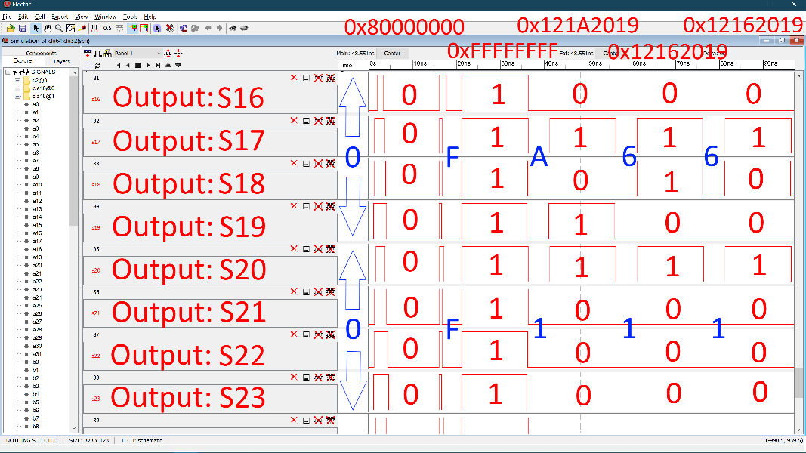
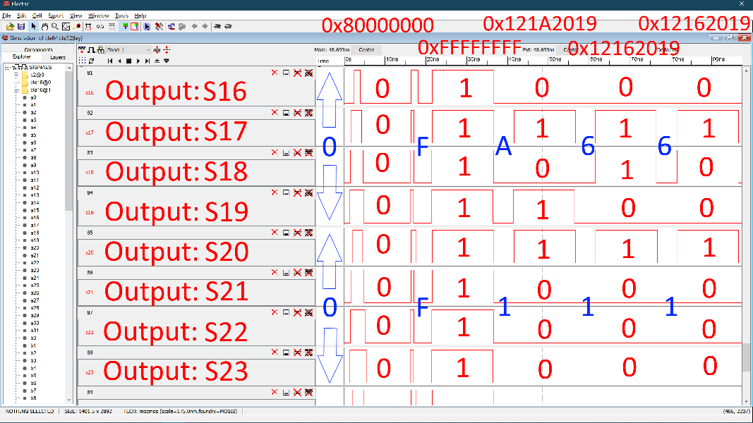
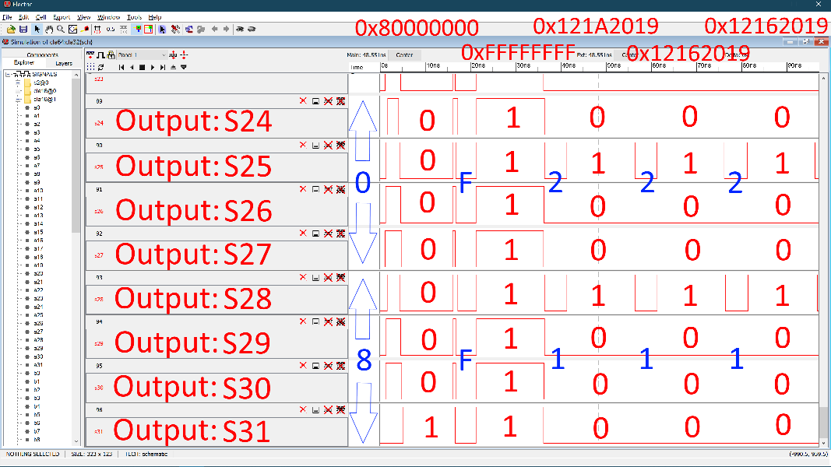
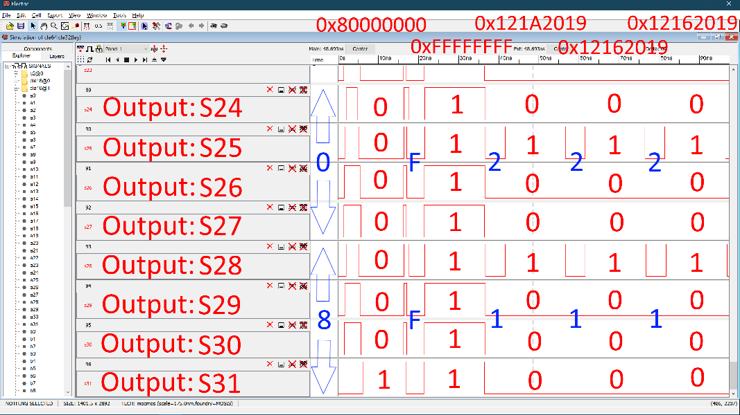
Waveforms – Output S(16:31)

Slide 44
Subtractions
Total of Five Subtractions
 | Input: A (Hexadecimal) | Input: B (Hexadecimal) | Expected Output: S (Hexadecimal)
First Subtraction | 0x80000000 | -0x00000001 = 0xFFFFFFFF | 0x7FFFFFFF
Second Subtraction | 0xFFFFFFFF | -0x80000000 = 0x80000000 | 0x7FFFFFFF
Third Subtraction | 0x121A2019 | -0x00040000 = 0xFFFC0000 | 0x12162019
Fourth Subtraction | 0x12162019 | -0x01130682 = 0xFEECF97E | 0x11031997
Fifth Subtraction | 0x12162019 | -0x09000681 = 0xF6FFF97F | 0x09161998

Slide 45
Subtractions
Total of Five Subtractions
 | Input: A (Decimal) | Input: B (Decimal) | Expected Output: S (Decimal)
First Subtraction | 2147483648 | -1 | 2147483647
Second Subtraction | 4294967295 | -2147483648 | 2147483647
Third Subtraction | 303702041 | -262144 | 303439897
Fourth Subtraction | 303439897 | -18024066 | 285415831
Fifth Subtraction | 303439897 | -150996609 | 152443288

Slide 46
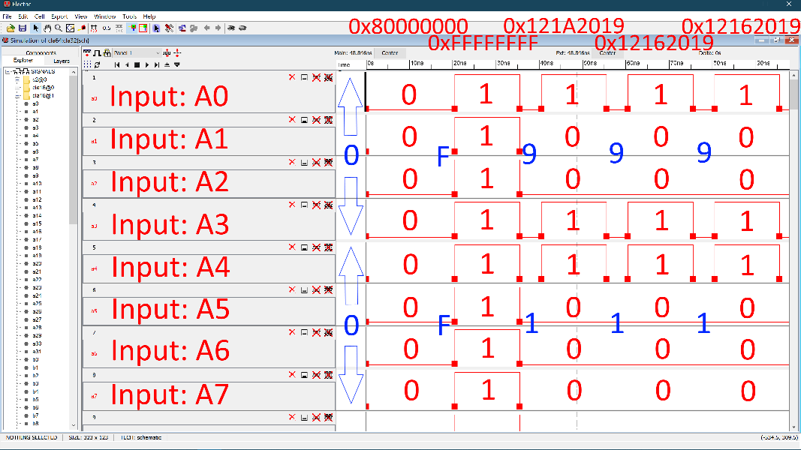
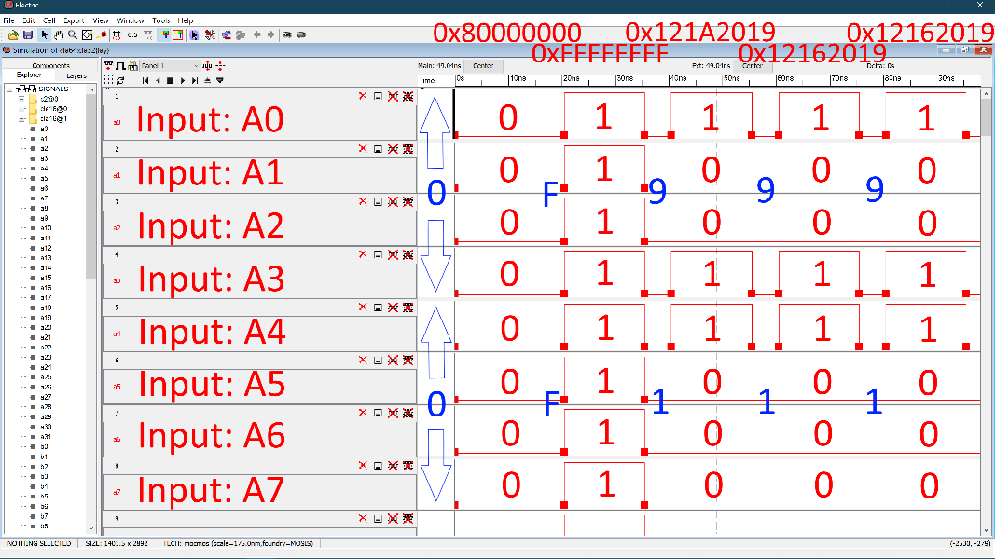
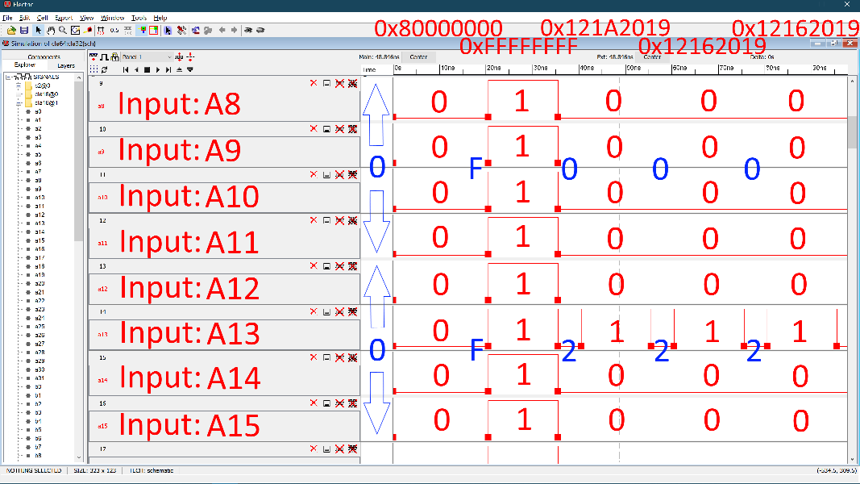
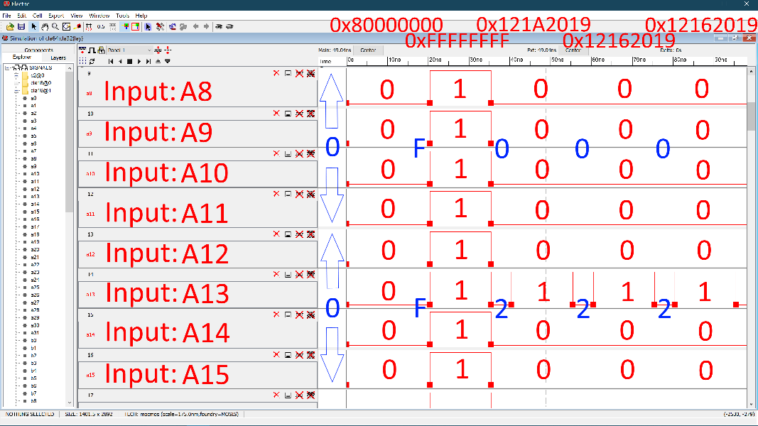
Waveforms – Input A(0:15)

Slide 47
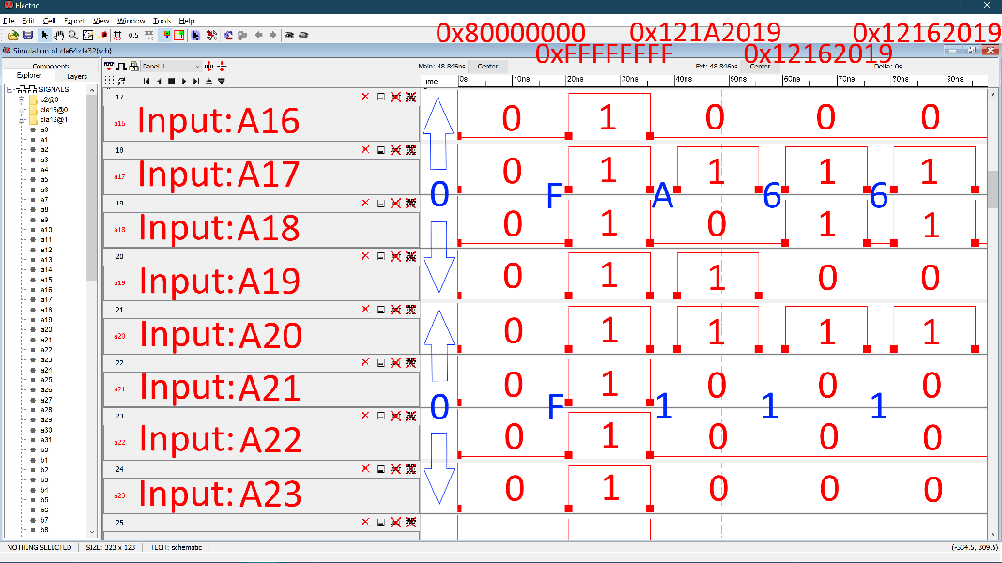
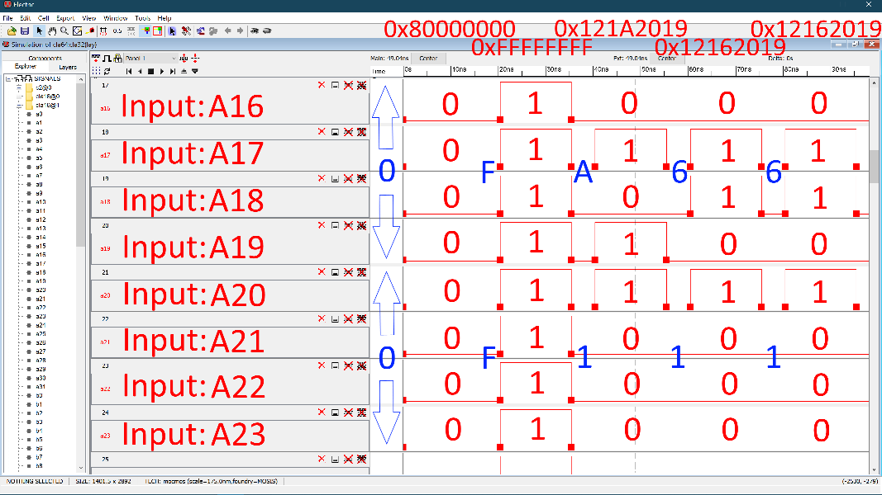
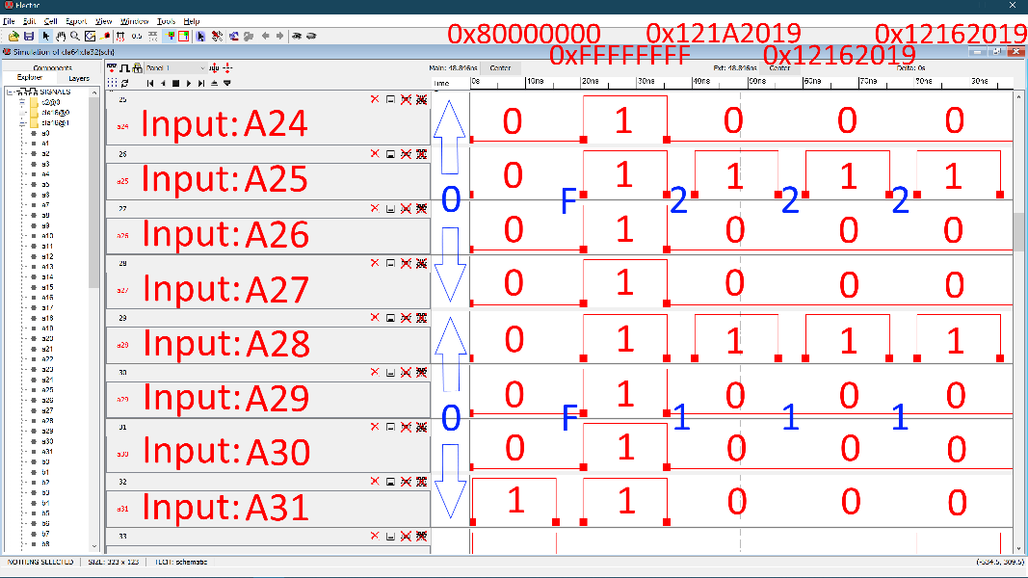
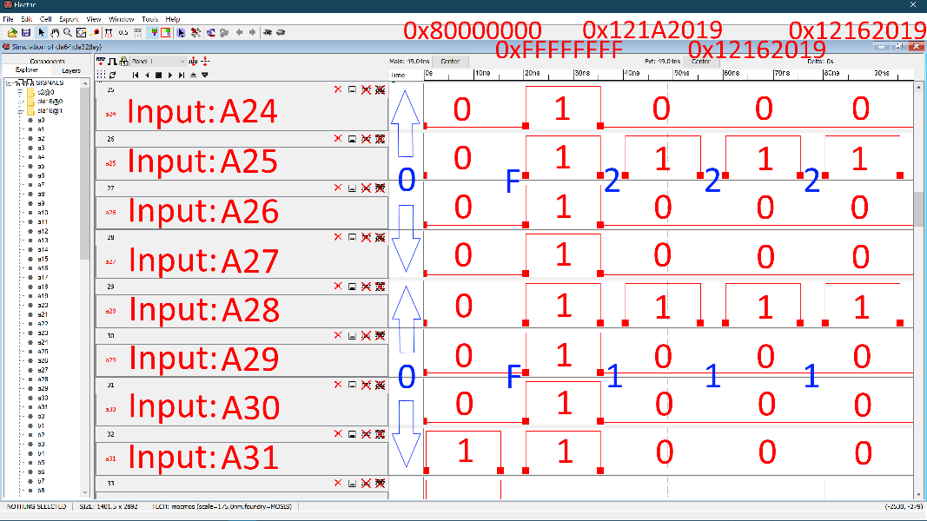
Waveforms – Input A(16:31)

Slide 48
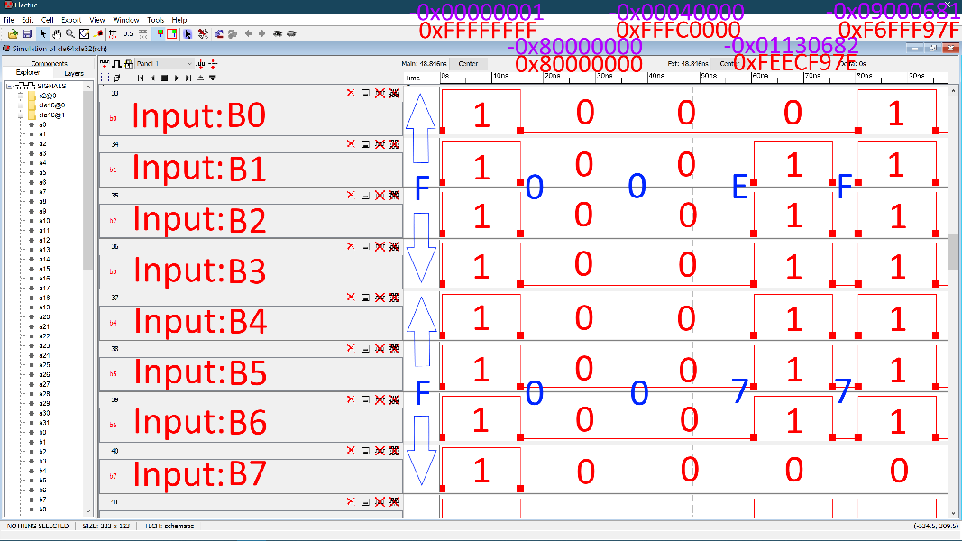
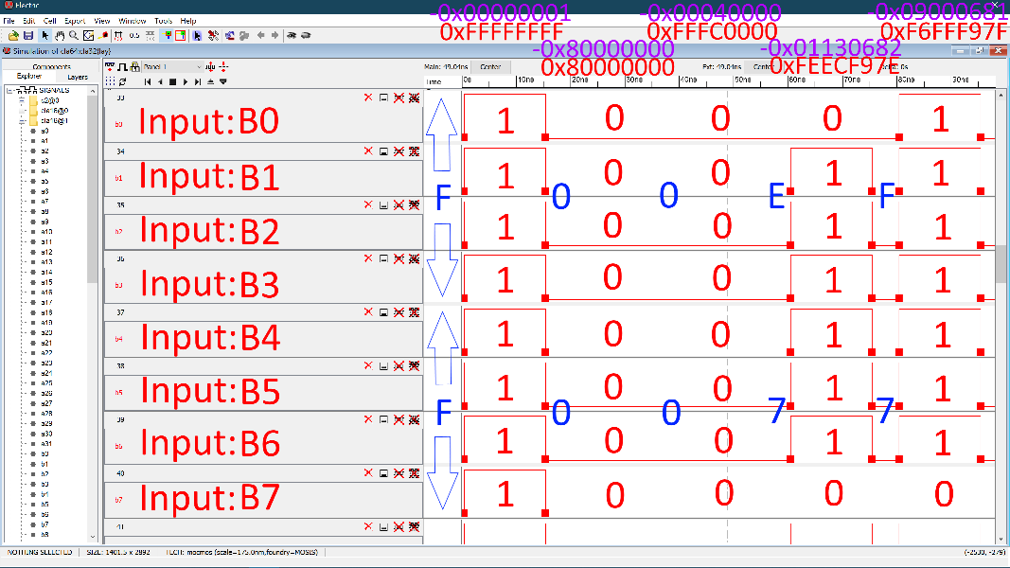
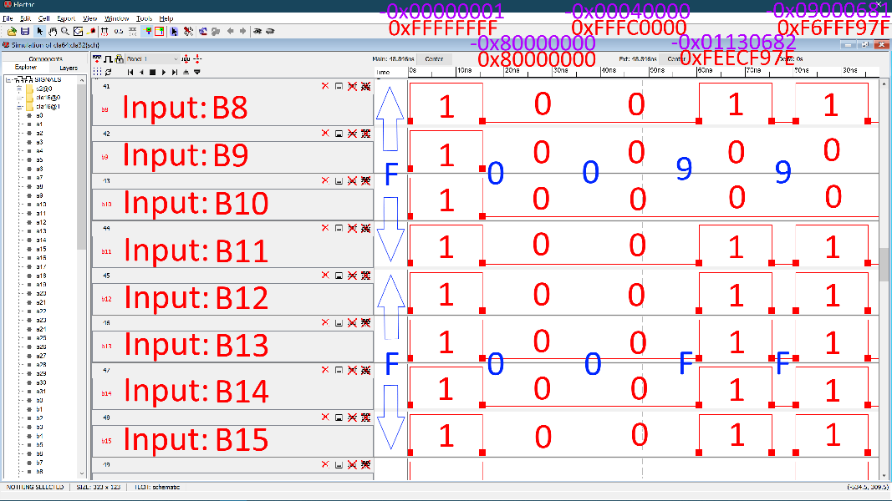
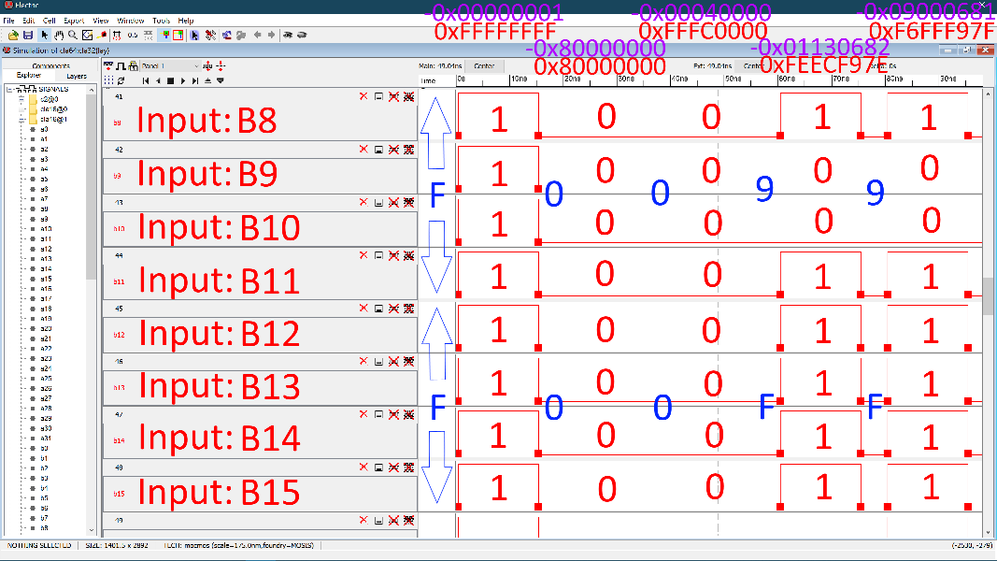
Waveforms – Input B(0:15)

Slide 49
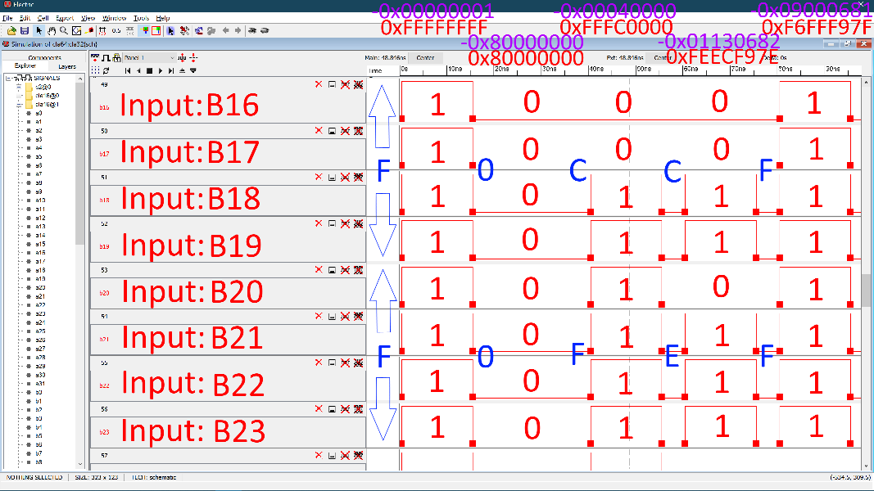
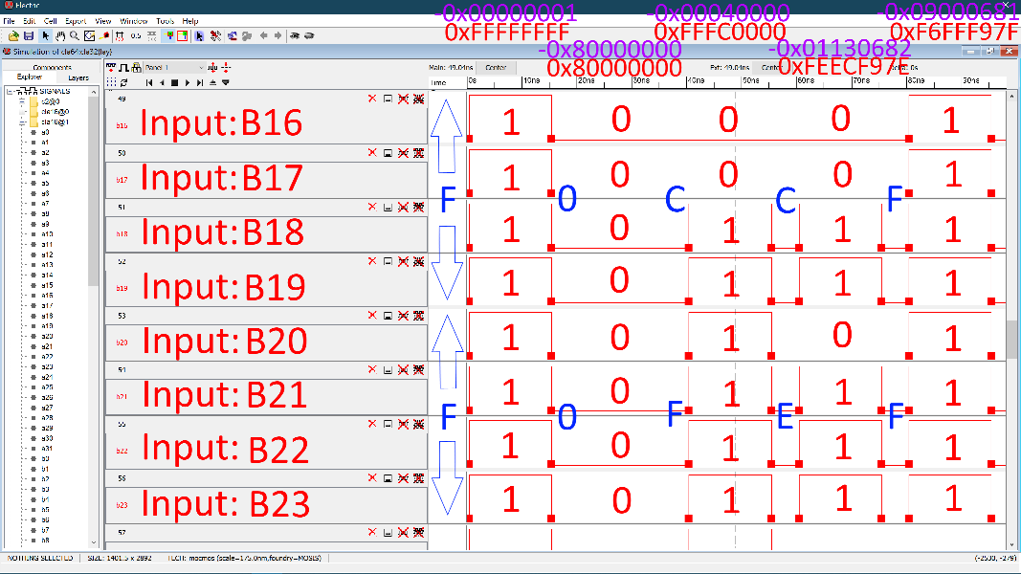
Waveforms – Input B(16:31)

Slide 50
Waveforms – Output S(0:15)

Slide 51
Waveforms – Output S(16:31)

Slide 52
Logic Simulations
It all checks out.
 | Expected Output (Hexadecimal) | Output Schematic (Hexadecimal) | Output Layout (Hexadecimal)
First Addition | 0x80000000 | 0x80000000 | 0x80000000
Second Addition | 0xFFFFFFFF | 0xFFFFFFFF | 0xFFFFFFFF
Third Addition | 0x121A2019 | 0x121A2019 | 0x121A2019
Fourth Addition | 0x12162019 | 0x12162019 | 0x12162019
Fifth Addition | 0x12162019 | 0x12162019 | 0x12162019
First Subtraction | 0x7FFFFFFF | 0x7FFFFFFF | 0x7FFFFFFF
Second Subtraction | 0x7FFFFFFF | 0x7FFFFFFF | 0x7FFFFFFF
Third Subtraction | 0x12162019 | 0x12162019 | 0x12162019
Fourth Subtraction | 0x11031997 | 0x11031997 | 0x11031997
Fifth Subtraction | 0x09161998 | 0x09161998 | 0x09161998

Slide 53
Logic Simulations
It all checks out.
 | Expected Output (Decimal) | Output Schematic (Decimal) | Output Layout (Decimal)
First Addition | 2147483648 | 2147483648 | 2147483648
Second Addition | 4294967295 | 4294967295 | 4294967295
Third Addition | 303702041 | 303702041 | 303702041
Fourth Addition | 303439897 | 303439897 | 303439897
Fifth Addition | 303439897 | 303439897 | 303439897
First Subtraction | 2147483647 | 2147483647 | 2147483647
Second Subtraction | 2147483647 | 2147483647 | 2147483647
Third Subtraction | 303439897 | 303439897 | 303439897
Fourth Subtraction | 285415831 | 285415831 | 285415831
Fifth Subtraction | 152443288 | 152443288 | 152443288

Slide 54
LTSPICE Code and Parasitic Extractions

Slide 55
SPICE Code
vdd vdd 0 DC 3.3 vgnd gnd 0 DC 0 va0 a0 0 PULSE(3.3 0 250n 100p 100p 500n 1000n) va1 a1 0 PULSE(3.3 0 250n 100p 100p 500n 1000n) ... va31 a31 0 PULSE(3.3 0 250n 100p 100p 500n 1000n) vb0 b0 0 DC 0 vb1 b1 0 DC 0 ... vb31 b31 0 DC 0 .meas TRAN tr0 TRIG V(s0) VAL=.33 RISE=1 TARG V(s0) VAL=2.97 RISE=1 .meas TRAN tr1 TRIG V(s1) VAL=.33 RISE=1 TARG V(s1) VAL=2.97 RISE=1 ... .meas TRAN tr31 TRIG V(s31) VAL=.33 RISE=1 TARG V(s31) VAL=2.97 RISE=1

Slide 56
SPICE Code
.meas TRAN tf0 TRIG V(s0) VAL=2.97 FALL=1 TARG V(s0) VAL=.33 FALL=1 .meas TRAN tf1 TRIG V(s1) VAL=2.97 FALL=1 TARG V(s1) VAL=.33 FALL=1 ... .meas TRAN tf31 TRIG V(s31) VAL=2.97 FALL=1 TARG V(s31) VAL=.33 FALL=1 .meas TRAN tplh0 TRIG V(a0) VAL=1.65 RISE=1 TARG V(s0) VAL=1.65 RISE=1 .meas TRAN tplh1 TRIG V(a1) VAL=1.65 RISE=1 TARG V(s1) VAL=1.65 RISE=1 ... .meas TRAN tplh31 TRIG V(a31) VAL=1.65 RISE=1 TARG V(s31) VAL=1.65 RISE=1 .meas TRAN tphl0 TRIG V(a0) VAL=1.65 FALL=1 TARG V(s0) VAL=1.65 FALL=1 .meas TRAN tphl1 TRIG V(a1) VAL=1.65 FALL=1 TARG V(s1) VAL=1.65 FALL=1 ... .meas TRAN tphl31 TRIG V(a31) VAL=1.65 FALL=1 TARG V(s31) VAL=1.65 FALL=1 .tran 1000n .include C:\Electric\kim_models.txt

Slide 57
Parasitic Extractions
Output | Capacitance
s0 | 6.129fF
s1 | 6.129fF
s2 | 6.37fF
s3 | 6.37fF
s4 | 6.37fF
s5 | 6.37fF
s6 | 6.37fF
s7 | 6.37fF
s8 | 6.37fF
s9 | 6.37fF
s10 | 6.37fF
s11 | 6.37fF
s12 | 6.37fF
s13 | 6.37fF
s14 | 6.37fF
s15 | 6.37fF
s16 | 7.288fF
s17 | 6.129fF
s18 | 6.129fF
s19 | 6.129fF
s20 | 6.129fF
s21 | 6.129fF
s22 | 6.129fF
s23 | 6.129fF
s24 | 6.129fF
s25 | 6.129fF
s26 | 6.129fF
s27 | 6.129fF
s28 | 6.129fF
s29 | 6.129fF
s30 | 6.129fF
s31 | 6.129fF

Slide 58
Parasitic Extractions
Component | RP (Ω) | RN (Ω)
Inverter (Tall) | 8.138 | 7.75
Inverter | 9.455 | 8.525
Inverter (no wells) | 9.455 | 8.525
NAND (A input) | 9.854 | 7.75
NAND (B input) | 9.688 | 9.817
NAND (Tall version, A input) | 9.3 | 9.61
NAND (Tall version, B input) | 6.2 | 9.106
XOR | 9.079 | 9.079
PG4 | 8.82975 | 6.717

Slide 59
Measurements in LTSPICE
Rise Time, Fall Time, and Propagation Delay for both Schematic and Layout

Slide 60
Waveforms – Input A

Slide 61
Waveforms – Input A

Slide 62
Waveforms – Input B

Slide 63
Waveforms – Input B

Slide 64
Schematic - Output S

Slide 65
Schematic - Output S
Also verifies -1 + 0 = -1
0xFFFFFFFF + 0x00000000 = 0xFFFFFFFF

Slide 66
Schematic Metrics
Bit | Rise Time (ps) | Fall Time (ps) | t_{plh} (ps) | t_{phl} (ps) | t_{p} (ps)
0 | 99.08 | 97.81 | 467.63 | 427.63 | 447.6255
1 | 103.41 | 101.43 | 481.84 | 438.37 | 460.1045
2 | 99.76 | 101.11 | 437.52 | 403.74 | 420.634
3 | 101.63 | 98.98 | 393.08 | 367.27 | 380.1725
4 | 98.07 | 100.29 | 467.68 | 426.55 | 447.116
5 | 103.42 | 101.45 | 481.84 | 438.38 | 460.1085
6 | 99.76 | 101.11 | 437.52 | 403.75 | 420.6385
7 | 101.63 | 98.98 | 393.08 | 367.27 | 380.177
8 | 98.07 | 100.29 | 467.68 | 426.51 | 447.0975
9 | 103.42 | 101.42 | 481.84 | 438.35 | 460.0955
10 | 99.76 | 101.12 | 437.52 | 403.73 | 420.6265
11 | 101.63 | 98.98 | 393.08 | 367.26 | 380.1695
12 | 98.07 | 100.21 | 467.68 | 426.48 | 447.081
13 | 103.42 | 101.41 | 481.84 | 438.32 | 460.081
14 | 99.76 | 101.11 | 437.52 | 403.69 | 420.605
15 | 101.63 | 98.97 | 393.08 | 367.24 | 380.1585

Slide 67
Schematic Metrics
Bit | Rise Time (ps) | Fall Time (ps) | Tplh (ps) | Tphl (ps) | Tp (ps)
16 | 97.61 | 99.92 | 467.58 | 426.89 | 447.233
17 | 103.42 | 101.45 | 481.84 | 438.37 | 460.105
18 | 99.76 | 101.11 | 437.52 | 403.74 | 420.634
19 | 101.63 | 98.98 | 393.08 | 367.27 | 380.1725
20 | 98.08 | 100.29 | 467.69 | 426.55 | 447.1165
21 | 103.42 | 101.45 | 481.84 | 438.38 | 460.109
22 | 99.76 | 101.11 | 437.52 | 403.75 | 420.6385
23 | 101.63 | 98.98 | 393.08 | 367.27 | 380.177
24 | 98.07 | 100.29 | 467.68 | 426.51 | 447.0975
25 | 103.42 | 101.42 | 481.84 | 438.35 | 460.0955
26 | 99.76 | 101.12 | 437.52 | 403.73 | 420.6265
27 | 101.63 | 98.98 | 393.08 | 367.26 | 380.17
28 | 98.07 | 100.21 | 467.68 | 426.48 | 447.081
29 | 103.42 | 101.41 | 481.84 | 438.32 | 460.081
30 | 99.76 | 101.11 | 437.52 | 403.69 | 420.605
31 | 101.63 | 98.98 | 393.08 | 367.24 | 380.159
Average Rise Time
100.74 ps
Average Fall Time
100.36 ps
Average Prop. Delay
427.0185 ps

Slide 68
Layout - Output S

Slide 69
Layout - Output S

Slide 70
Layout Metrics
Bit | Rise Time (ns) | Fall Time (ns) | tplh (ns) | tphl (ns) | tp (ns)
0 | 1.6947 | 1.0267 | 2.1432 | 1.6739 | 1.908515
1 | 1.7027 | 1.0296 | 2.2131 | 1.7266 | 1.969865
2 | 1.7836 | 1.0709 | 2.2570 | 1.7569 | 2.00693
3 | 1.8039 | 1.0846 | 2.1466 | 1.6678 | 1.90721
4 | 1.7148 | 1.0365 | 2.1549 | 1.6780 | 1.916425
5 | 1.7102 | 1.0329 | 2.2162 | 1.7285 | 1.97233
6 | 1.7861 | 1.0728 | 2.2582 | 1.7576 | 2.007895
7 | 1.8048 | 1.0850 | 2.1470 | 1.6680 | 1.90749
8 | 1.7176 | 1.0382 | 2.1561 | 1.6788 | 1.91745
9 | 1.7131 | 1.0342 | 2.2174 | 1.7292 | 1.97327
10 | 1.7894 | 1.0753 | 2.2599 | 1.7585 | 2.00918
11 | 1.8086 | 1.0868 | 2.1486 | 1.6689 | 1.908745
12 | 1.7210 | 1.0401 | 2.1576 | 1.6797 | 1.918685
13 | 1.7411 | 1.0466 | 2.2293 | 1.7364 | 1.98281
14 | 1.7919 | 1.0772 | 2.2611 | 1.7592 | 2.01013
15 | 1.8096 | 1.0873 | 2.1490 | 1.6692 | 1.909095

Slide 71
Layout Metrics
Bit | Rise Time (ns) | Fall Time (ns) | Tplh (ns) | Tphl (ns) | Tp (ns)
16 | 1.7274 | 1.0442 | 2.1601 | 1.6819 | 1.92098
17 | 1.7027 | 1.0296 | 2.2131 | 1.7266 | 1.969865
18 | 1.7776 | 1.0663 | 2.2541 | 1.7552 | 2.00463
19 | 1.7970 | 1.0813 | 2.1437 | 1.6661 | 1.904915
20 | 1.7088 | 1.0330 | 2.1520 | 1.6763 | 1.914135
21 | 1.7033 | 1.0299 | 2.2134 | 1.7268 | 1.97009
22 | 1.7801 | 1.0682 | 2.2553 | 1.7559 | 2.0056
23 | 1.7979 | 1.0817 | 2.1441 | 1.6663 | 1.905195
24 | 1.7116 | 1.0346 | 2.1533 | 1.6771 | 1.91517
25 | 1.7063 | 1.0312 | 2.2146 | 1.7275 | 1.971025
26 | 1.7835 | 1.0708 | 2.2570 | 1.7568 | 2.006885
27 | 1.8017 | 1.0835 | 2.1457 | 1.6672 | 1.90645
28 | 1.7150 | 1.0366 | 2.1548 | 1.6780 | 1.916405
29 | 1.7346 | 1.0437 | 2.2263 | 1.7347 | 1.980475
30 | 1.7860 | 1.0727 | 2.2582 | 1.7575 | 2.007835
31 | 1.8028 | 1.0841 | 2.1461 | 1.6675 | 1.9068
Average Rise Time
1.7540 ns
Average Fall Time
1.0568 ns
Average Prop. Delay
1.951 ns

Slide 72
Comparison
The parasitic effects drastically slow the performance of the CLA
Compared to schematic results, the layout:
Avg. Rise time is 17.41 times slower
Avg. Fall Time is 10.53 times slower
Avg. Prop. Delay is 4.57 times slower

Slide 73
Other Measurements in LTSPICE
Steady-State Power Dissipation, Total Chip Area, Total Transistor Count

Slide 74
Power
I(VDD)
P = VDD * I(VDD)
P = 3.3 V * 286.828 µA
P = 946.5324 µW

Slide 75
Total Chip Area
A = dX * dY
A = 1400λ * 2886λ
A = 4,040,400*λ^2
A = 4,040,400 * (.175 µm)^2
A = 123,737.25 sq. µm

Slide 76
Total Transistor Count
Transistor count of Gates
$T_{inv}=2$
$T_{nand}=4$
$T_{xor}=12$
Transistor count of LCU Modules
$T_{C1}=2\left(4\right)+2=10$
$T_{C2}=4\left(4\right)+2\left(2\right)=20$
$T_{C3}=6\left(4\right)+3\left(2\right)=30$
$T_{PG4}=8+2=10$

Slide 77
Total Transistor Count
4-bit CLA
$T_{CLA−4}=4\left(30\right)+10+20+2\left(30\right)+10$
$T_{CLA−4}=220$
16-bit CLA
$T_{CLA−16}=4\left(220\right)+10+20+2\left(30\right)+10$
$T_{CLA−16}=980$

Slide 78
Total Transistor Count
32-bit Fast Adder (Final Product)
$T_{CLA−32}=2\left(980\right)+10$
$T_{CLA−32}=1970$

Slide 79
Conclusion
We made it!

Slide 80
Conclusion
Can perform addition and subtraction (by inputting two’s complement of a binary number)
It’s bigger and bulkier than the Ripple Carry Adder
But it’s faster!
Space-Time Tradeoff
We use more space and design more complex logic circuits
In return, we get faster performance when performing binary addition/subtraction operations

